Slide 1
LASSO REGRESSION
TuringMinds.Ai
REGULARIZATION TECHNIQUE
REDDAPPA M R
03-02-2023

Slide 2
LASSO REGRESSION
Introduction
Definition of Lasso Regression
Comparison with other regression methods
Purpose and benefits of Lasso Regression

Slide 3

LASSO REGRESSION
Theory and Mathematics
L1 Regression, Lasso Cost Function
Lasso cost function = RSS $+ λ\sum_{i=0}^{n}{\left|β_{i}\right|}$
RSS =$\sum_{i=0}^{n}{{\left(y_{i}−{\hat{y}}_{i}\right)}^{2}}$
$λ$: Regularization parameter
y_{i} : The actual response value for the i^{th} observation
ŷ_{i} : The predicted response value for the i^{th} observation

Slide 4
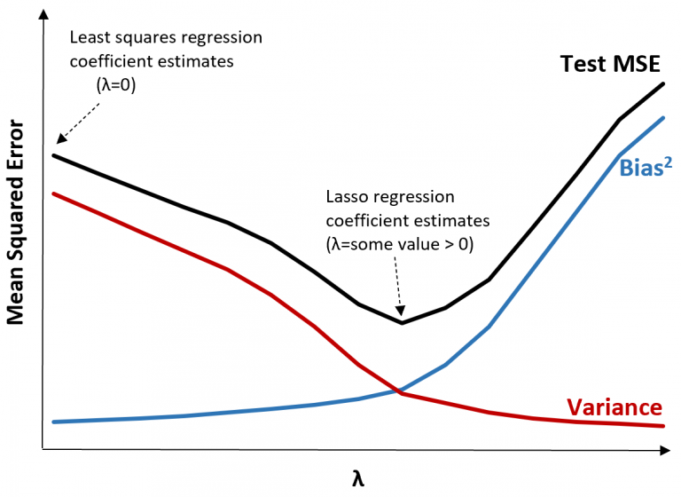
LASSO REGRESSION
Theory and Mathematics

Slide 5
LASSO REGRESSION
Applications
Feature Selection
Predictive Modelling
High dimensional data analysis
Model Simplification
Handling Multicollinearity
Advantages and Limitations
Pros and Corns of Lasso Regression

Slide 6
LASSO REGRESSION
Conclusion
Eliminates the impact of least important features.

Slide 7
LASSO REGRESSION
THANK YOU

